Slide 1
3D Image Segmentation and Quantification of Lysosomes
4/12/2025

Slide 2
LAST MEETING
My progress these last few weeks:
Checked the size.
Included additional metrics such as mean and standard deviation.
Comparison MANUAL.vs.AUTOMATIC.
Now the script can assign serial order numbers to lysosome and cell IDs.
Review possible over-detection in some images.
I am working in the automatization of same parameters to avoid or reduce over deteccion on all images.
Verify cases where there are lysosomes outside with a different cell ID.
I will start working on this point next week.
OREN: One addition/clarification - need to find a way to limit cell size to a certain (lower) limit so to exclude these fragments being counted as a cell…

Slide 3
FILES
Airy scan_40A_UAS-TMEM-HA_CB_0h_1_051222
Airy scan_40A_UAS-TMEM-HA_CB_0h_2_051222
Airy scan_40A_UAS-TMEM-HA_CB_4h_1_051222
Airy scan_40A_UAS-TMEM-HA_CB_4h_2_051222
TMEM-HA 6h CB airy_3_170722
40A_UAS-TMEM192-3xHA x 40A 71G10 MARCM_around 12h - for quantification_4 Airy-CBs_300425
40A_UAS-TMEM192-3xHA x 40A 71G10 MARCM_around 12h - for quantification_3 Airy-CBs_300425
40A_UAS-TMEM1923x-HA x 71G10 40A MARCM_L3_2_Airy_010724
40A_UAS-TMEM1923x-HA x 71G10 40A MARCM_L3_1_Airy_010724

Slide 4
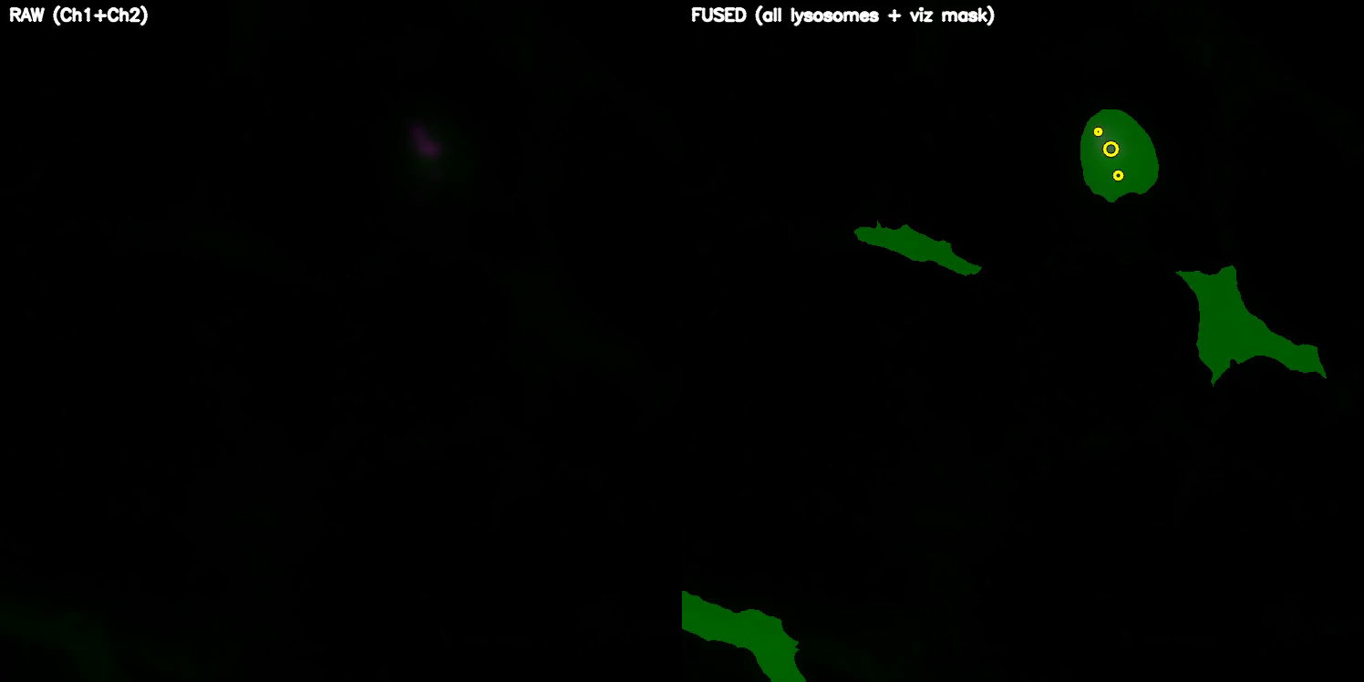
Airy scan_40A_UAS-TMEM-HA_CB_0h_1_051222

Slide 5
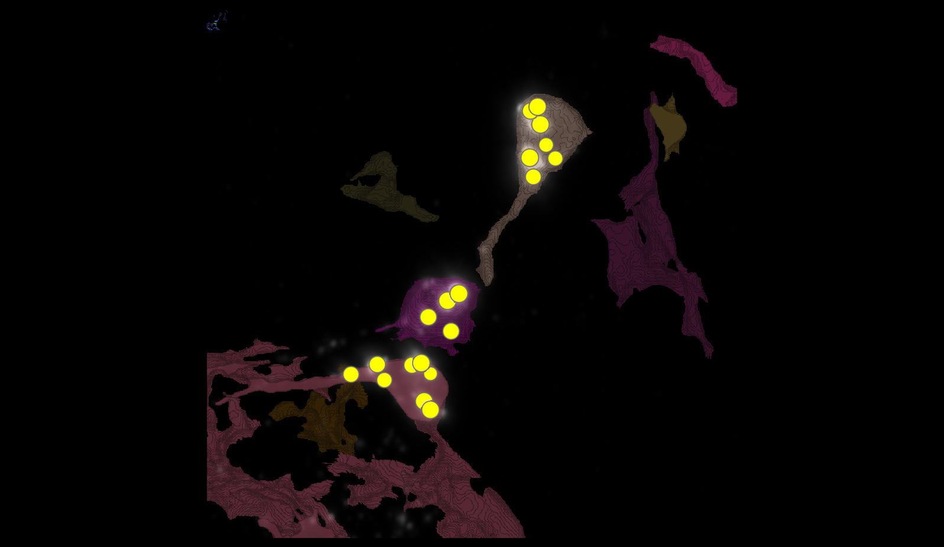
Airy scan_40A_UAS-TMEM-HA_CB_0h_1_051222

Slide 6
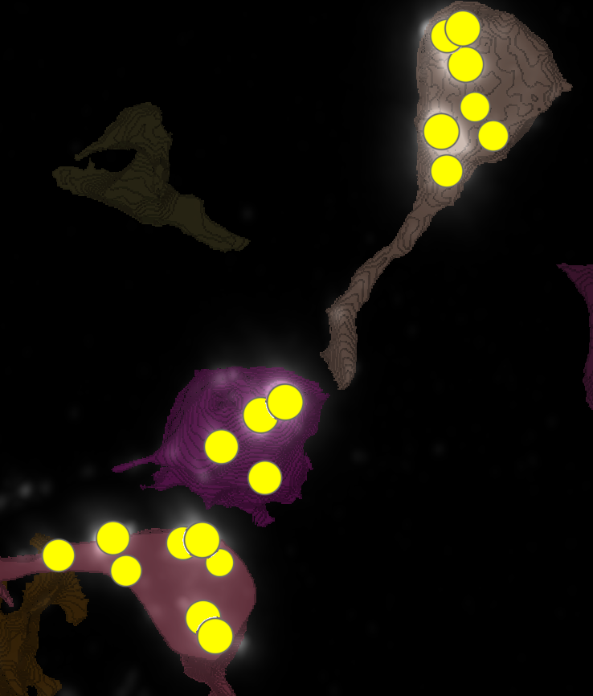
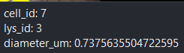
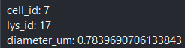
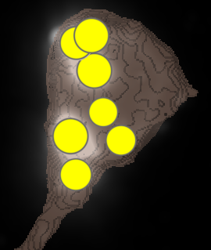
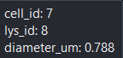
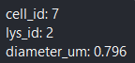
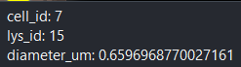
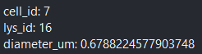
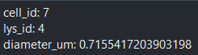
Airy scan_40A_UAS-TMEM-HA_CB_0h_1_051222

Slide 7
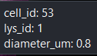
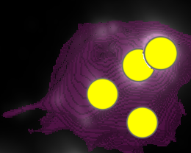
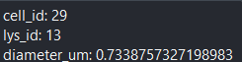
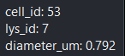
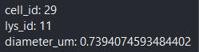
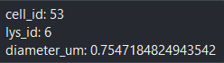
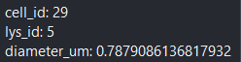
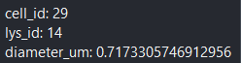
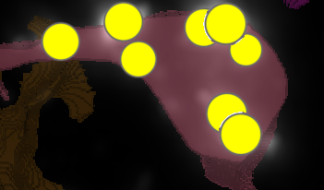
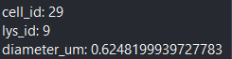
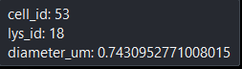
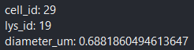
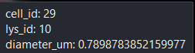
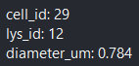
Airy scan_40A_UAS-TMEM-HA_CB_0h_1_051222

Slide 8
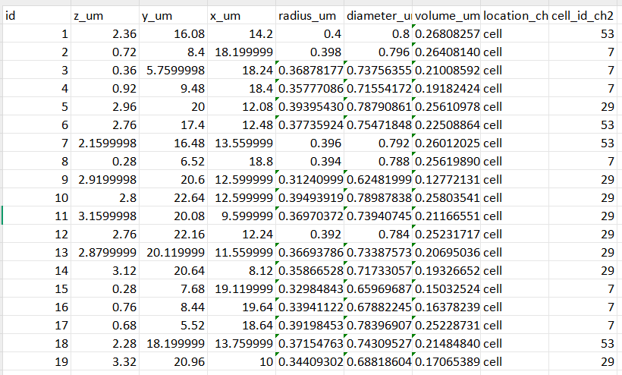
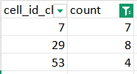
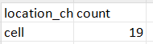
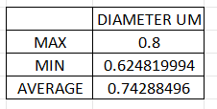
Airy scan_40A_UAS-TMEM-HA_CB_0h_1_051222

Slide 9
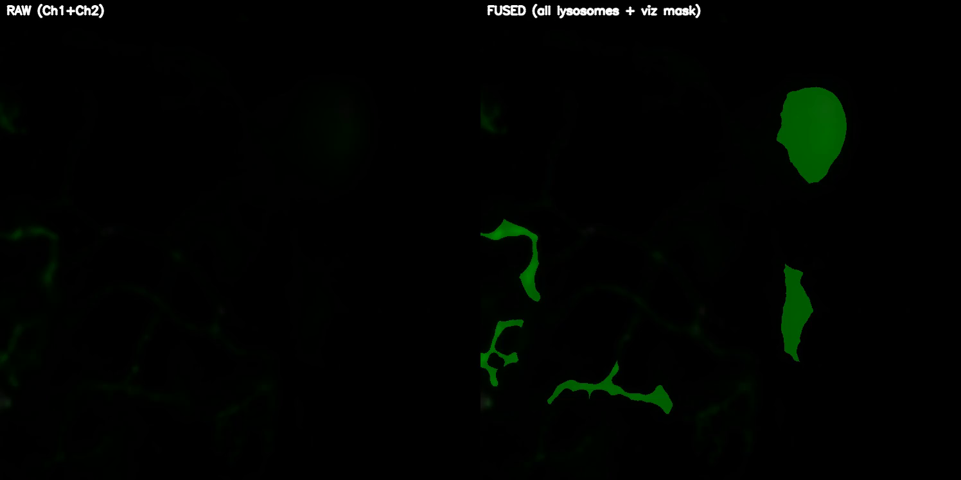
Airy scan_40A_UAS-TMEM-HA_CB_0h_2_051222

Slide 10
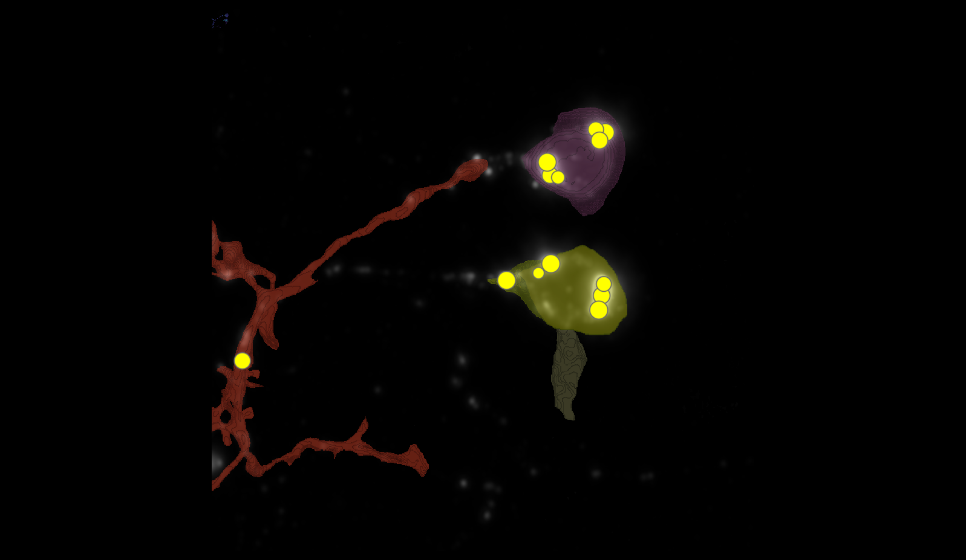
Airy scan_40A_UAS-TMEM-HA_CB_0h_2_051222

Slide 11
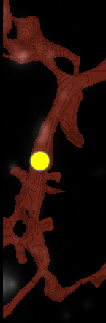
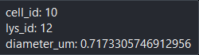
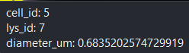
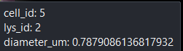
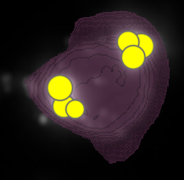
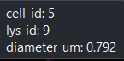
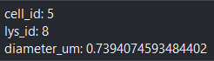
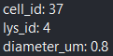
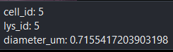
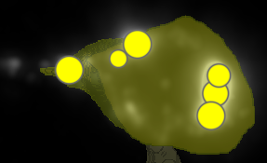
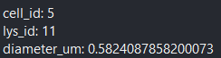
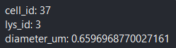
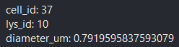
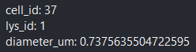
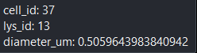
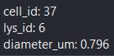
Airy scan_40A_UAS-TMEM-HA_CB_0h_2_051222

Slide 12
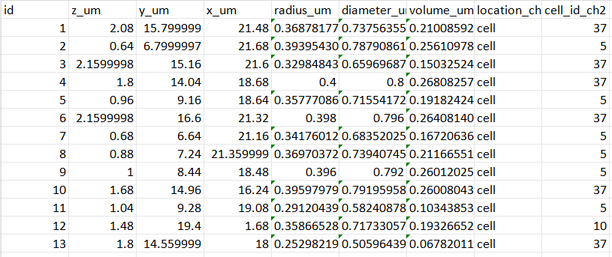
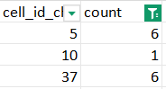
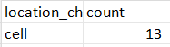

Airy scan_40A_UAS-TMEM-HA_CB_0h_2_051222

Slide 13

Airy scan_40A_UAS-TMEM-HA_CB_4h_1_051222

Slide 14

Airy scan_40A_UAS-TMEM-HA_CB_4h_1_051222

Slide 15



























Airy scan_40A_UAS-TMEM-HA_CB_4h_1_051222

Slide 16




Airy scan_40A_UAS-TMEM-HA_CB_4h_1_051222

Slide 17

Airy scan_40A_UAS-TMEM-HA_CB_4h_2_051222

Slide 18

Airy scan_40A_UAS-TMEM-HA_CB_4h_2_051222

Slide 19



























Airy scan_40A_UAS-TMEM-HA_CB_4h_2_051222

Slide 20




Airy scan_40A_UAS-TMEM-HA_CB_4h_2_051222

Slide 21

TMEM-HA 6h CB airy_3_170722

Slide 22

TMEM-HA 6h CB airy_3_170722

Slide 23







































TMEM-HA 6h CB airy_3_170722

Slide 24






















TMEM-HA 6h CB airy_3_170722

Slide 25


























TMEM-HA 6h CB airy_3_170722

Slide 26





TMEM-HA 6h CB airy_3_170722

Slide 27

40A_UAS-TMEM192-3xHA x 40A 71G10 MARCM_around 12h - for quantification_4 Airy-CBs_300425

Slide 28

40A_UAS-TMEM192-3xHA x 40A 71G10 MARCM_around 12h - for quantification_4 Airy-CBs_300425
lys_id:2
lys_id:1
lys_id:3

Slide 29




40A_UAS-TMEM192-3xHA x 40A 71G10 MARCM_around 12h - for quantification_4 Airy-CBs_300425

Slide 30

40A_UAS-TMEM192-3xHA x 40A 71G10 MARCM_around 12h - for quantification_3 Airy-CBs_300425

Slide 31

40A_UAS-TMEM192-3xHA x 40A 71G10 MARCM_around 12h - for quantification_3 Airy-CBs_300425

Slide 32





















40A_UAS-TMEM192-3xHA x 40A 71G10 MARCM_around 12h - for quantification_3 Airy-CBs_300425

Slide 33




40A_UAS-TMEM192-3xHA x 40A 71G10 MARCM_around 12h - for quantification_3 Airy-CBs_300425

Slide 34

40A_UAS-TMEM1923x-HA x 71G10 40A MARCM_L3_1_Airy_010724

Slide 35

40A_UAS-TMEM1923x-HA x 71G10 40A MARCM_L3_1_Airy_010724

Slide 36

























40A_UAS-TMEM1923x-HA x 71G10 40A MARCM_L3_1_Airy_010724

Slide 37




40A_UAS-TMEM1923x-HA x 71G10 40A MARCM_L3_1_Airy_010724

Slide 38




40A_UAS-TMEM1923x-HA x 71G10 40A MARCM_L3_1_Airy_010724

Slide 39

40A_UAS-TMEM1923x-HA x 71G10 40A MARCM_L3_2_Airy_010724
28
96
45
2
85
95

Slide 40





40A_UAS-TMEM1923x-HA x 71G10 40A MARCM_L3_2_Airy_010724
cell | automatic | manual
2 | 39 | NOT DATA
28 | 23 | 20
45 | 32 | 15
85 | 10 | 12
95 | 22 | 20
96 | 24 | 25

